Slide 1
Intelligent Dashboard
Team: TNF
Team members:
Ishwor Upadhaya, Lajal Shrestha, Sandesh Gyawali, Yojak Basnet

Slide 2
Idea
AI-powered Manufacturing Intelligence Dashboard : Simulates production timelines, analyzes weather impact on delivery, and provides actionable recommendations to optimize operations and profit.
Conversational Manufacturing Assistant : An AI chatbot that uses company data to answer manufacturing-related questions such as production steps, cost, and time estimation.

Slide 3
Patent used
Intelligent Conversational Research Assistant (TOP2-288)
User can either type a question or verbally ask a question and the system provides geospatially-aware answers
It offers:
Geospatial data
Weather Data & Forecasting (WD&F)

Slide 4
Problem
Despite clear evidence that adverse weather disrupts transportation and logistics, studies show limited understanding of the full magnitude of these impacts on freight movement (Source: https://transet.lsu.edu/wp-content/uploads/sites/16/2019/08/19ITSUTA02-PIF.pdf)
Study from the Federal Highway Administration (FHWA) estimated that weather-related delay costs the industry $8 billion to $9 billion annually (source: https://ops.fhwa.dot.gov/publications/fhwahop16044/chap1.htm#:~:text=Background,billion%20to%20%249%20billion%20annually)

Slide 5
Problem
Manufacturers collect vast volumes of data from IoT & ERP systems, still many report they are data rich, but insight poor ( source: https://arxiv.org/abs/1909.00413?utm_source=chatgpt.com )
Despite extensive deployment of ERP, and IoT systems, the integration of these technologies into decision-making workflows is still under-explored, implying that human oversight remains central in manufacturing operations

Slide 6
Problem summary
There’s still a missing link in logistics management when it comes to weather-related disruptions.
There’s still a lack in a system capable enough of converting vast amount of manufacturing data into meaningful, and actionable insights.
There’s a heavy reliance on human decision-making in manufacturing processes.

Slide 7
Scope of our solution
Fills the gap in logistics by simulating production timelines, assessing weather impacts on deliveries, and generating actionable insights.
Bridges the gap in manufacturing by transforming company data into actionable insights, enabling instant answers to production, cost, and time-related queries without relying on manual decision-making.

Slide 8
Revenue
Our platform generates revenue through B2B subscription and data-integration services:
Manufacturers subscribe monthly or annually based on AI features (e.g., simulation, forecasting, and chatbot analytics).
Companies pay for custom integration with their ERP, MES, or IoT systems.
By reducing delays, improving planning, and keeping production on track, companies save money and see clear results—making them more likely to choose long-term and premium plans.

Slide 9
Future growth
Can expand across global manufacturing, and logistics where data-driven decision tools are in high demand.
With every deployment, the system becomes more intelligent and accurate, strengthening its competitive edge.
The system can be adapted for pharmaceuticals, automotive, and energy, covering any sector where production and logistics planning depend on environmental or operational conditions.

Slide 10
Future Enhancement
End-to-End simulation: The next phase of development focuses on building end-to-end simulation capabilities, enabling manufacturers and logistics operators to model every part of their operations in a single, intelligent environment.
Autonomous Decision Loops: Move to automated decision execution. For example, dynamically adjusting machine schedules, sourcing orders, or shipment routes in real time based on AI recommendations.

Slide 11
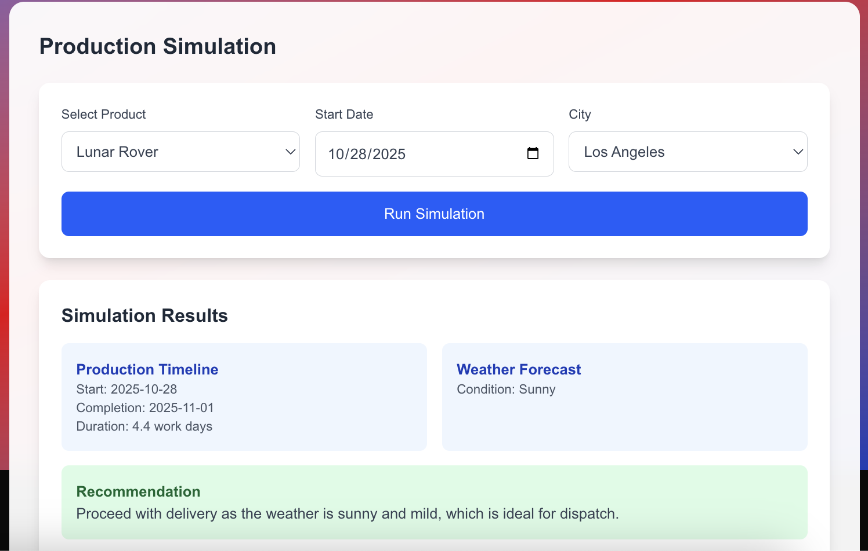
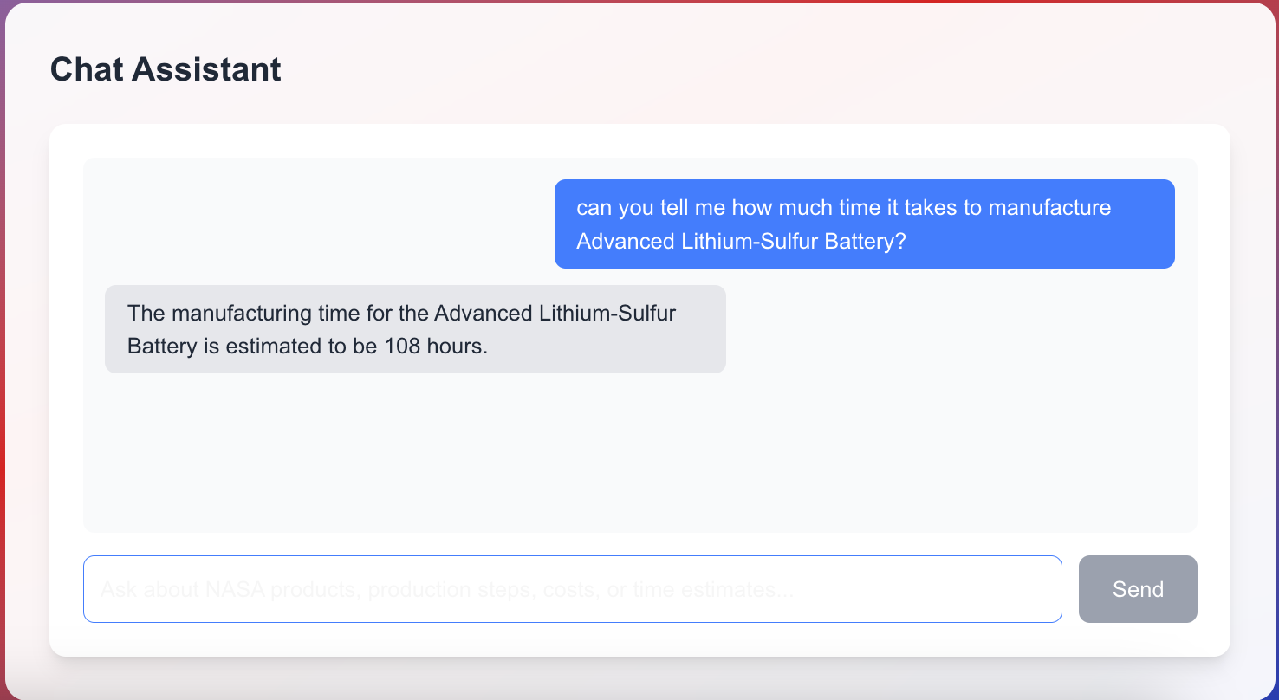
Sample output

